Slide 1
SFS Pricing
SFS RC RCA FPI RAA

Slide 2
Pricing Application (PrApp) is the SFS tool to price deals considering the costs for funding, credit risk and operational expenses.

Slide 3
General Overview of PrApp
PrApp calculates present values representing the pricing components on transaction level
PrApp consists of:
a central calculation kernel, embedded in AWARD
master data tables in AWARD containing e.g. the Interest rate curves, spread curves, PDs, currency holidays, country and currency settings
a web interface to allow for connecting to the PrApp functionality
Multiple frontends for users to run individual pricings or batch run pricings, e.g. BTS Pricing, and SuperTRUMP in the US, PPR/EVA NB, Rate Card functionalities
PrApp is the “source of truth” for profitability metric of deals

Slide 4
Different user interfaces allow the option to price individual deals for deal metrics or the option to “batch” price for portfolio profitability or scenario analysis.

Slide 5
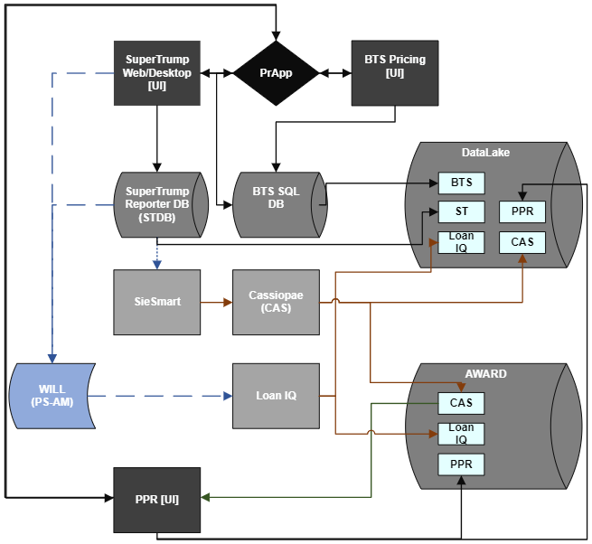
Pricing Architecture
For Individual Pricings:
SuperTRUMP
BTS Pricing
For batch pricing:
PPR
Rate Cards

Slide 6
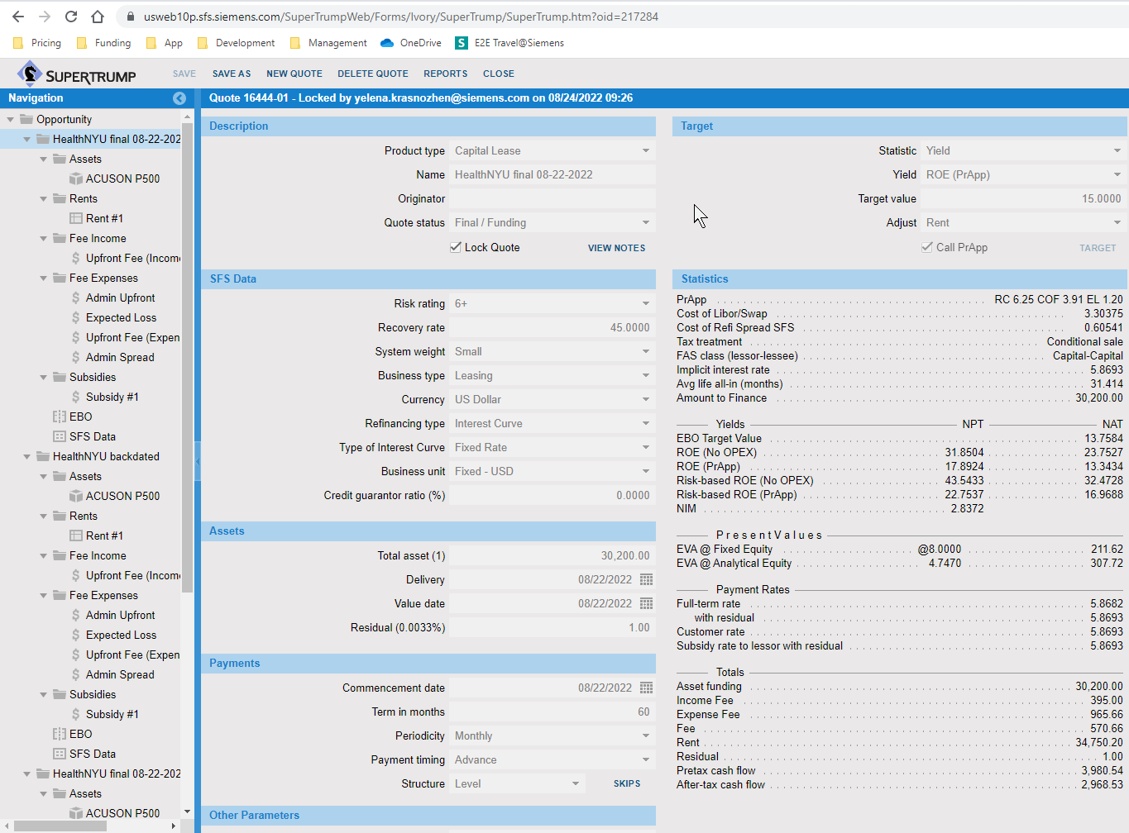
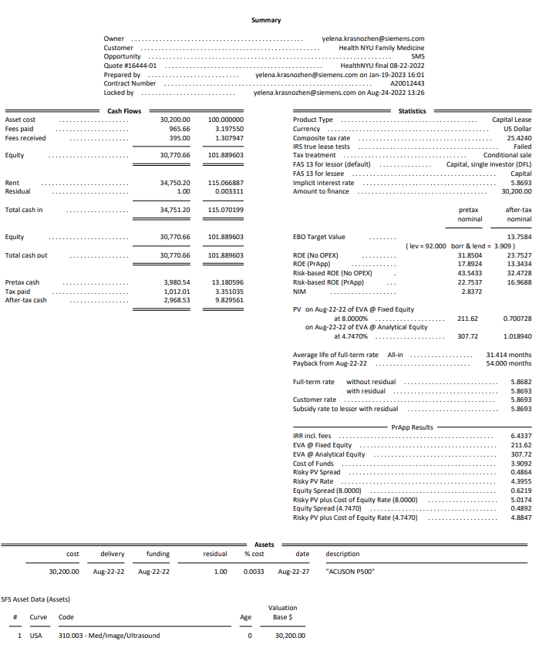
SuperTRUMP

Slide 7
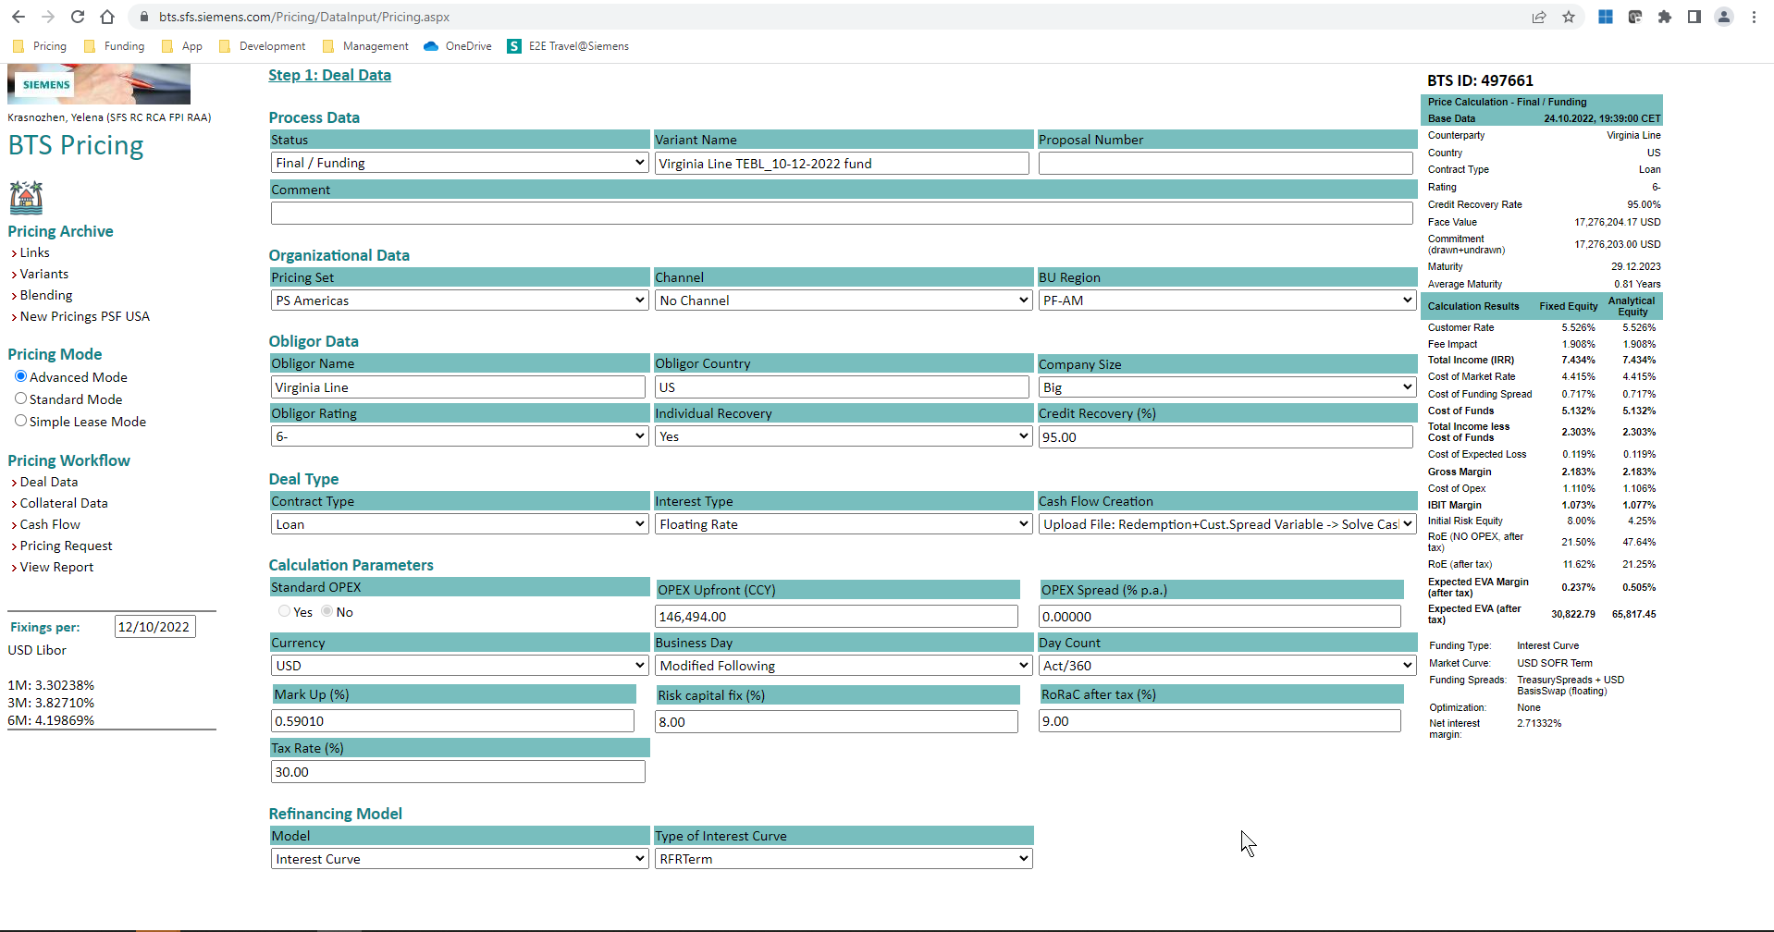
BTS Pricing

Slide 8
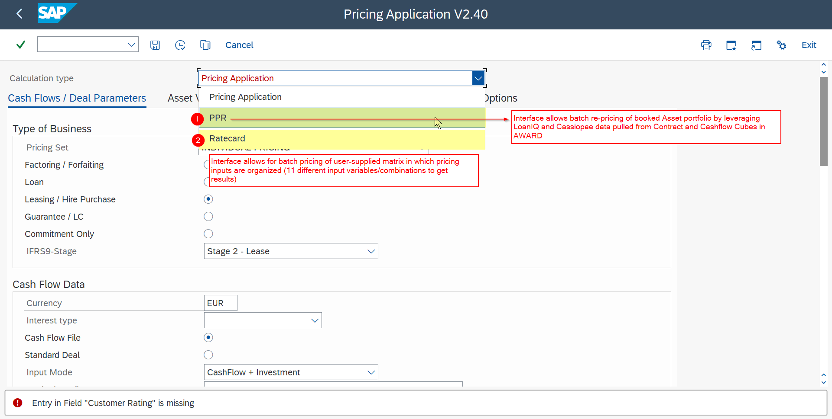
EVA NB / PPR and Rate Cards via AWARD

Slide 9
Batch Functionality
Rate Card: Functionality to run multiple scenarios
Scenario combinations are passed to the application as .txt file, result file is again .txt
4 Valuation modes
          Leases (Annuities/RV), Bullet Loans Fix/Float
          OPEX: Upfront Fee or Spread
          Solve for ROE or EVA
          Current Funding Rates
Thousands of different scenarios can be run on a regular basis to monitor hurdle prices for combinations of different ratings, tenors, OPEX assumptions, IAC codes, ROE levels, etc.
PPR: Functionality to (re)price booked portfolios from AWARD data
4 Valuation modes
    Static valuation
    Mark to Market
    New business valuation
    IFRS9 calculation
Results joined with in AWARD contract cube and available in AWARD and DataLake

Slide 10
What are the cost components of a pricing?

Slide 11
Components follow an “allocation price” logic
Cost of Funds |  | Cost of debt SFS borrows from TRE (determined by cash flow structure) Cost of Funds = Cost of Market Rate + Cost of Refi Spread (includes corporate adder, cross-currency swap, bid-ask spread)
Expected Loss (EL) | Exposure at Default | Difference between outstanding amount (determined by cash flow structure) and asset recovery value (determined by asset collateral curve)
 | LiED (Loss in Event of Default) | 1 – Recovery Rate (RR) Recovery Rate considers the extent to which the principal on defaulted debt can be recovered
 | Default Probability | Determined by Obligor Rating
Cost of Equity |  | Risk equity is the amount of risk capital to be allocated to a certain transaction to cover the unexpected loss. Fixed Equity is based on the overall risk floor for the SFS debt portfolio (8%) Analytical Equity is the capital position SFS will put into an individual transaction (determined by the riskiness of the deal, i.e.: rating, system weight, remaining outstanding after credit hit and average maturity)
Fees (Expense) |  | Amount fully payable, irrespective of customer default
Operating Expense | OPEX (“RAC” or “Admin Fee”) | Expense incurred by business through normal operations (includes, rent, equipment, inventory, payroll, etc.)

Slide 12
Pricing Output and Profitability Metrics
IRR (Internal Rate of Return): includes the rate to the customer as well as the effect of any fees
Key Measures of Profitability
ROE (Return on Equity):
the ratio of return produced by the deal in relation to the size of the equity investment
This is a performance ratio
EVA (Economic Value Added):
return provided to equity investor in excess of the minimum return requirement where this minimum return requirement is also called the “cost of equity” or “RORAC”
This is a hurdle; specifically, if ROE > Cost of Equity (RORAC) then EVA > 0

Slide 13
What is the output of Pricing?

Slide 14
Pricing Output and Profitability Metrics
IRR (Internal Rate of Return): includes the rate to the customer as well as the effect of any fees
Key Measures of Profitability
ROE (Return on Equity):
the ratio of return produced by the deal in relation to the size of the equity investment
This is a performance ratio
EVA (Economic Value Added):
return provided to equity investor in excess of the minimum return requirement where this minimum return requirement is also called the “cost of equity” or “RORAC”
This is a hurdle; specifically, if ROE > Cost of Equity (RORAC) then EVA > 0

Slide 15
Overview of Risk Equity

Slide 16
Overview of Risk Equity
Both ROE and EVA are driven by “Risk Equity”
ROE (after Tax) = Income after Tax / Risk Equity
EVA (after Tax) = Income after Tax - Cost of Equity
where Cost of Equity = Risk Equity * Hurdle Rate
So, WHAT is it?
The amount of capital required, without regulatory considerations, to cover unexpected losses and avoid delinquency in an average worst case scenario.
There are two types that we consider:
Fixed Equity: generic level used for comparability (8.0% default)
Analytical Equity (also called “Economic Equity”,“Risk Capital” is the same as “Risk Equity” (AWARD) or “Allocated Equity” (HFM)): the risk contribution of an individual transaction

Slide 17
Components of Risk Equity
Risk Equity can be split in four components:
      SFS Markup
      Baseline
      Credit Risk Equity
          Loss Given Default: How much money do I lose if my customer goes bankrupt?
              LGD = Exposure – Asset Recovery – Credit Recovery – Cash Collateral
                Asset Recovery is based on the Asset Collateral curve
                Credit Recovery is based on generic or back-tested assumptions
          Probability of Default: How likely are my customers to go bankrupt?
              Simulation driven by initial Obligor rating, contract term, upgrades/downgrades of obligors
      Asset Risk

Slide 18
Exposure
Initial Purchase Price
Risk Equity Drivers Map
-
Loss Given Default
Cash Collaterals
Evaluation-ID
SFS Markup
-
Asset Recovery
IAC code
-
Generic
Credit Recovery
Obligor Rating
Credit Risk Equity
Specific
Individual LiED
EVA / ROE
+
Obligor Rating
Monte Carlo simulation of credit defaults
Default probability
Default Drivers
Guarantor Rating
Contract Term
Correlation
Industry (ISIC)
Concentration
Risk Equity
1.6%
Baseline Risk
x
Exposure (incl. Siemens)
Monte Carlo simulation of credit defaults
Simulated Defaults (incl. rating 10/20)
Asset Recovery volatility
Volatility table
IAC code
Asset Risk Equity
Correlation
IAC code
Unguaranteed RV’s
Residual Values
-
RV guarantees

