Slide 1
C-STAR@Mendix
User Manual for PS-EA & PS-AM
January 2021

Slide 2
Content
1
Introduction and general settings 3
2
Non-Committee process PS-EA & PS-AM 8
3
Credit Committee process PS-EA 16
4
Credit Committee process PS-AM 19
5
Contact 23

Slide 3
Replace the manual process of collecting
internal credit approvals, required signatures
and e-mails from travelling (senior) management
located all over the world by an automated,
mobile friendly workflow solution.
C-STAR vision statement

Slide 4

C-STAR showcase
Target Group
App Features
Data & Interfaces
Total number of users: 250 (2 BUs / 6 Legal Entities)
Role 1: Risk Managers
Role 2: Lending Authority Holders, Legal Entity and BU Management
Role 3: Sales / Workout Managers
Role 4: Committee Secretary (Risk Rating)
Feature 1: All relevant data, documents and process history available at a glance
Feature 2: Structured archiving of all decisions
Feature 3: Automated e-mail notifications
Feature 4: User-friendly mobile view
Feature 5: Pre-filled Authority Holders
Feature 6: Flexible delegation / substitution rule
Feature 7: Parallel steps where possible
Data:
Credit decision documents (Credit Report, Addendum to Approval, Workout Report,..)
Lending Authority tables of PS-EA and PS-AM
Credit decisions, committee meeting minutes
Interfaces:
CREDI (digitized credit document of PS-EA)
WILL (digitized opportunity memo workflow of PS-AM)
Needs
Business Value
Testimonial
Business Challenge 1: Collecting approval and document signatures of (senior) management located all over the world / during their travels
Business Challenge 2: Align credit approval processes of different SFS business, countries and legal entities
Business Challenge 3: Support Risk Management in selecting the right decision-makers
Business Challenge 4: Build a complex authorization structure to ensure confidentiality of Bank data
Value 1: Increase of productivity / efficiency
Value 2: Ensure integrity of credit decisions
Value 3: Audit-conform / transparent documentation
User friendly
Covering the complex approval workflows in a very efficient way
Reduce media discontinuity

Slide 5

Background of the Mendix project
  Shutdown of Secure SharePoint in 2021
  → Replace existing C-STAR tool
  Mendix as new software for workflow applications in SFS
  Rebuild and improve C-STAR based on user stories by Risk Management
Link to C-STAR (open via Google Chrome):
https://app-mx-cstar.openshift.eagledc.siemens.com

Slide 6
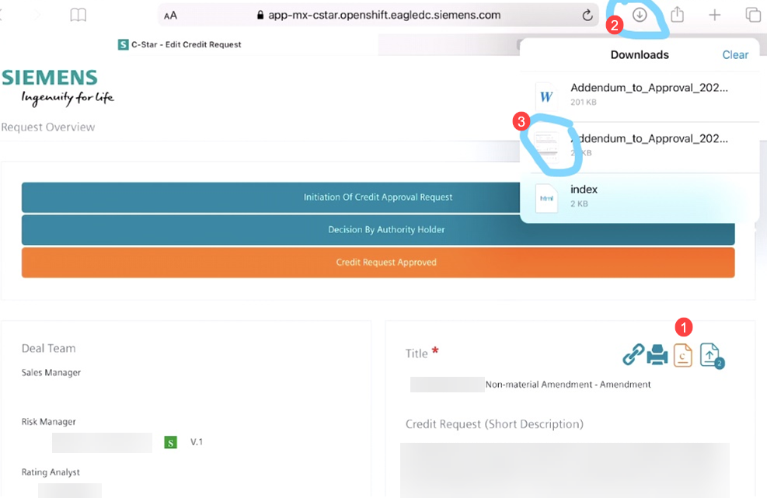
Use of mobile devices
  C-STAR works on mobile devices (iPhone, iPads, etc.)
  Please check your device setting:
  Siemens authentication needed (PingID)
  Browser settings for document handling (e.g. to open credit report):
    iPad opens the document directly within the browser (new tab)
    OR
    iPad downloads the document which is then stored on the device (see screenshot on the right)

Slide 7
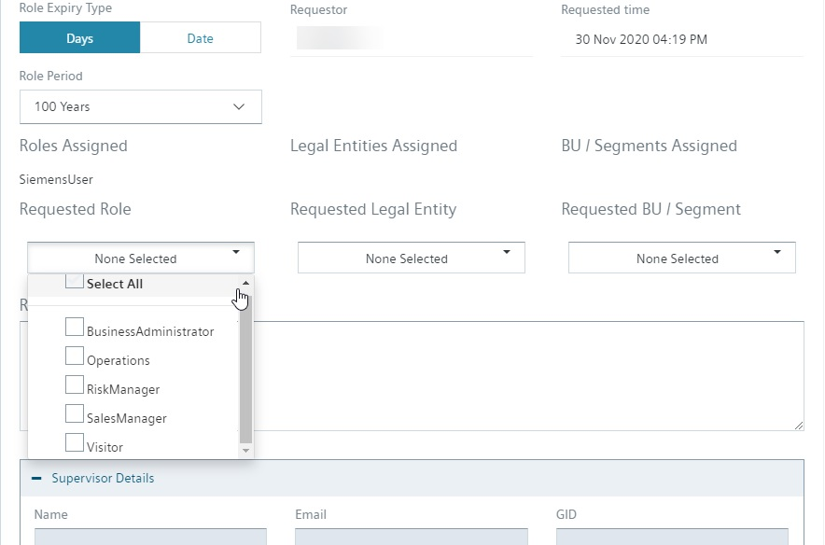
How to get access – example Risk Management authorizations
Link to C-STAR:
https://app-mx-cstar.openshift.eagledc.siemens.com
Open C-STAR and select
“Requested Role”
“Requested Legal Entity”
“Requested BU / Segment”
RiskManager, OtherCommitteeParticipant
+ AuthorityHolder, if lending authority competence exists

Slide 8
Non-Committee process
PS-EA & PS-AM

Slide 9
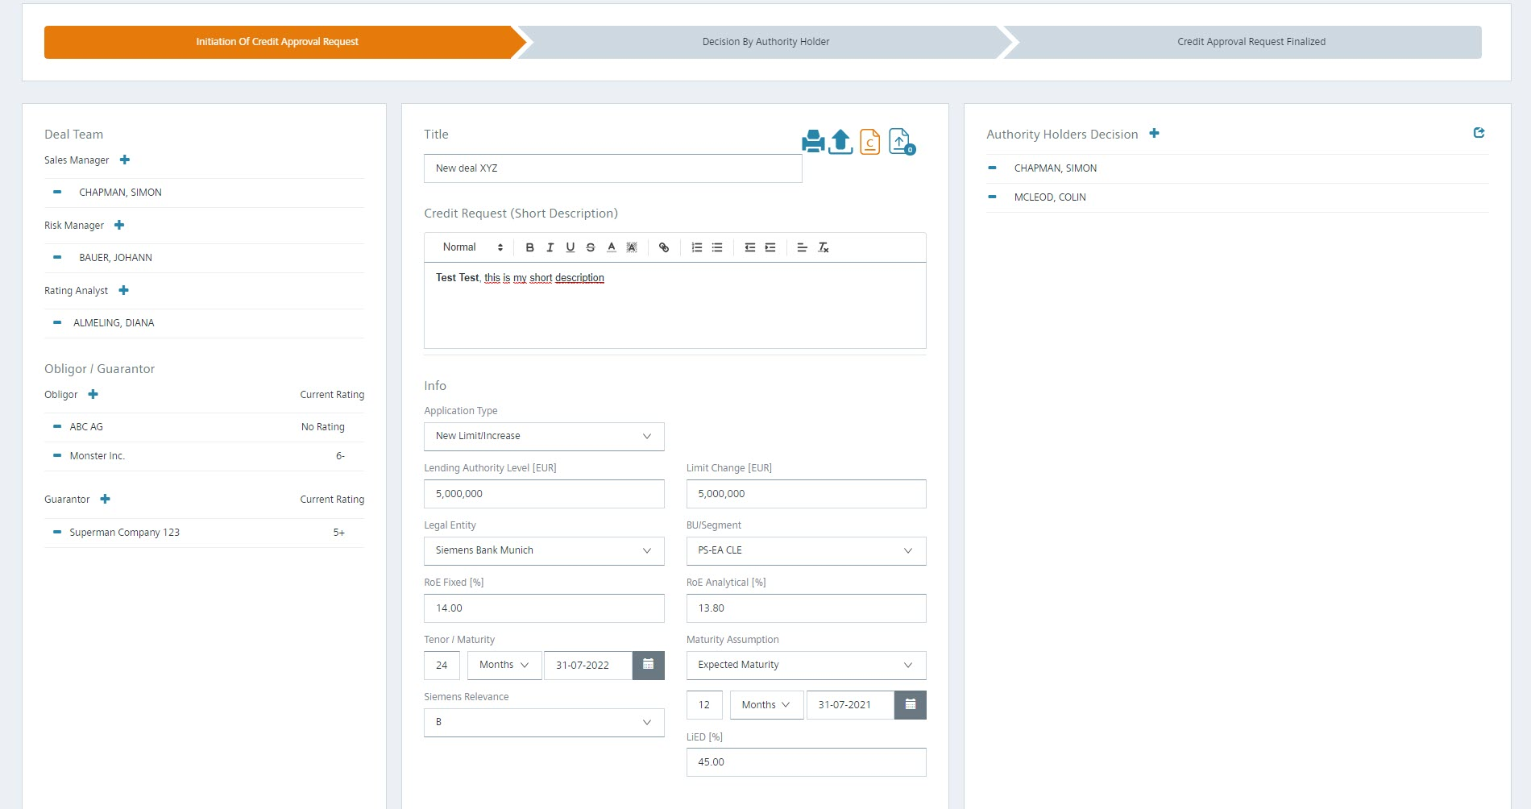
Risk Management phase “Initiation of Credit Approval Request“ I
Link to „SBA Lending and Workout Authorities.xlsx” (SBA only)
Button 1) (printer) Print approval document incl. signatures
Button 2) (arrow) Upload approval document (e.g. Credit Report PDF)
Button 3) (orange document icon with „c“) Open approval document (e.g. Credit Report PDF)
Button 4) (blue document icon with arrow) Open / attach further documents (e.g. Credit Committee Presentation)
Sales Manager
At least one person needs to sign the request (if ”Sales Manager Signature“ = yes in tile 5 - see next slide)
Risk Manager
All persons listed need to sign the request

Slide 10
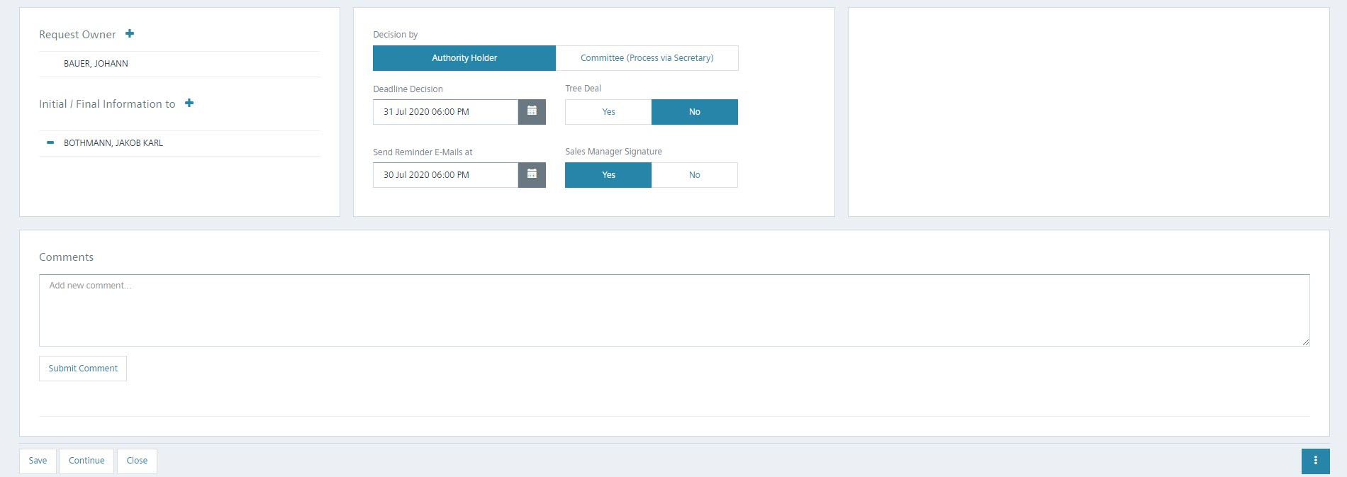
Risk Management phase “Initiation of Credit Approval Request“ II
Authority Holder Document need to be approved by individual persons based on the table of authorization
Bank: ”SBA Regional / Local“, ”SBA CRO“, “SBA Sales and CRO“ or “SBA Head of Debt and CRO“
US: ”Regional / Local“, “BU CEO and CRO“ or “BU CEO, CRO and CFO“
Committee (Process via Secretary) Document need to be presented to the committee with involvement by the committee secretary
Bank: “SBA Head of Debt, CRO and CFO“, “SBA Credit Committee“ or “SBA Credit Committee and Consent SBA AR“
US: “SFS CEO and CRO / CFO“, “SFS Credit Committee“ or “SFS Credit Committee and Consent SFS AR“
Request Owner
Risk Manager receiving all e-mails to track approval workflow
Initial / Final Information to
Persons who should receive an information e-mail as soon as a request has been started and once it has been finished
Tree Deal (SBA only)
More than one deal team set up within SBA to support competing bidding groups. Strictly confidentiality provisions apply. Sharing information beyond the deal team is not allowed.
Sales Manager Signature
Signature from at least one of the selected sales mangers (deal team) is needed before the request is approved.
Save
Saves the request in its current phase / status
Continue
Pushes the request into the next phase / starts the approval process
Cancel
Cancel and archive request. No reworking possible; request is not visible any longer.
Reset
Start approval process in phase “Initiation of Credit Approval Request“ again

Slide 11
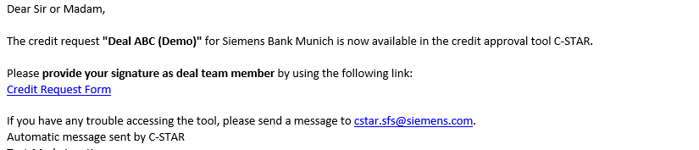
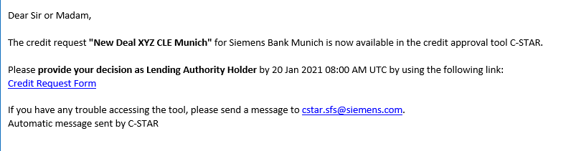
Starting point to provide Sales / Risk vote (to support and ask for approval)
Option 1: E-mail
Incl. direct link to the request (no differentiation between mobile or desktop link):
  Option 2: Direct link to C-STAR
  https://app-mx-cstar.openshift.eagledc.siemens.com

Slide 12
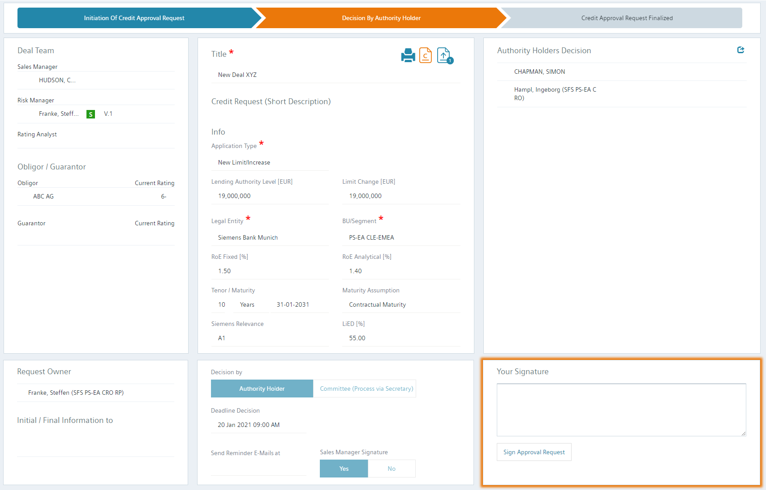
Signature by Deal Team (Sales & Risk Management)
All decisions of authorities
Approved
Approved with Conditions
Declined
All signatures by Sales / Risk Management (deal team)
Signed
Open approval document (e.g. Credit Report PDF) (orange document icon with „c“)
Open additional documents (e.g. Credit Committee presentation)
Orange frame around tiles which require action
→ Click on “Sign Approval Request“ to give your vote to support the credit application

Slide 13
Starting point to provide Lending Authority decision
Option 1: E-mail
Incl. direct link to the request (no differentiation between mobile or desktop link):
  Option 2: Direct link to C-STAR
  https://app-mx-cstar.openshift.eagledc.siemens.com

Slide 14
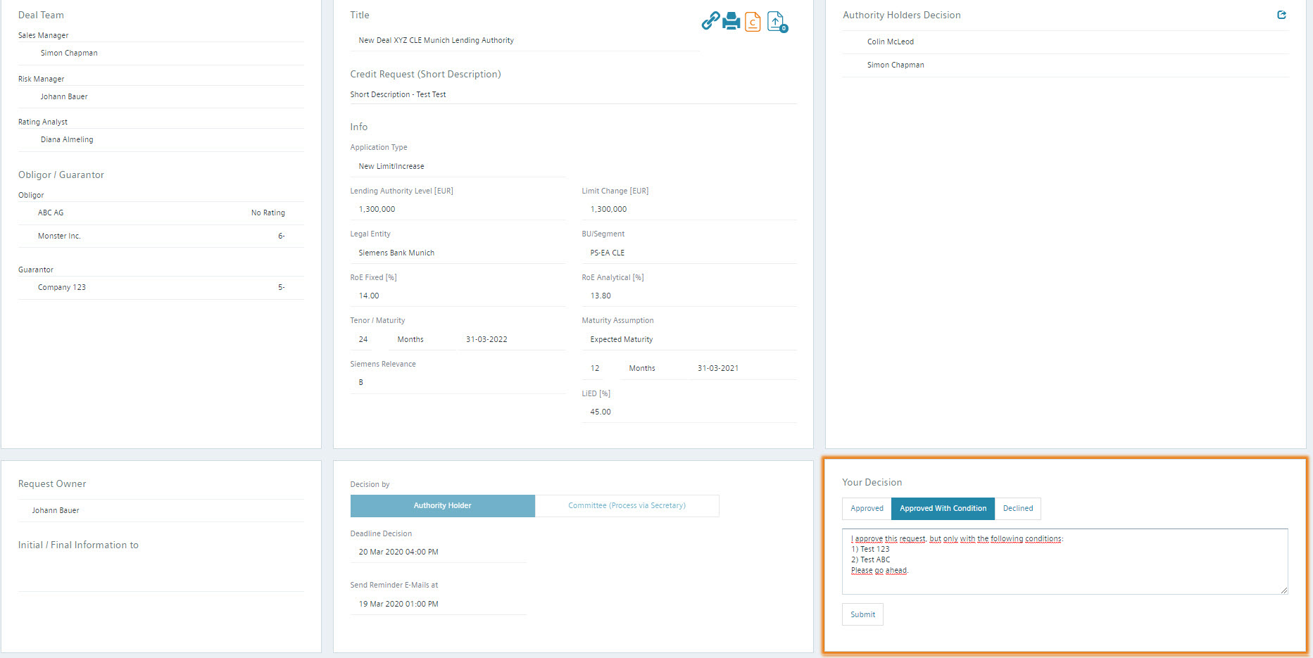
“Decision by Authority Holder“ I
Orange frame around tiles which require user action in the specific phase

Slide 15
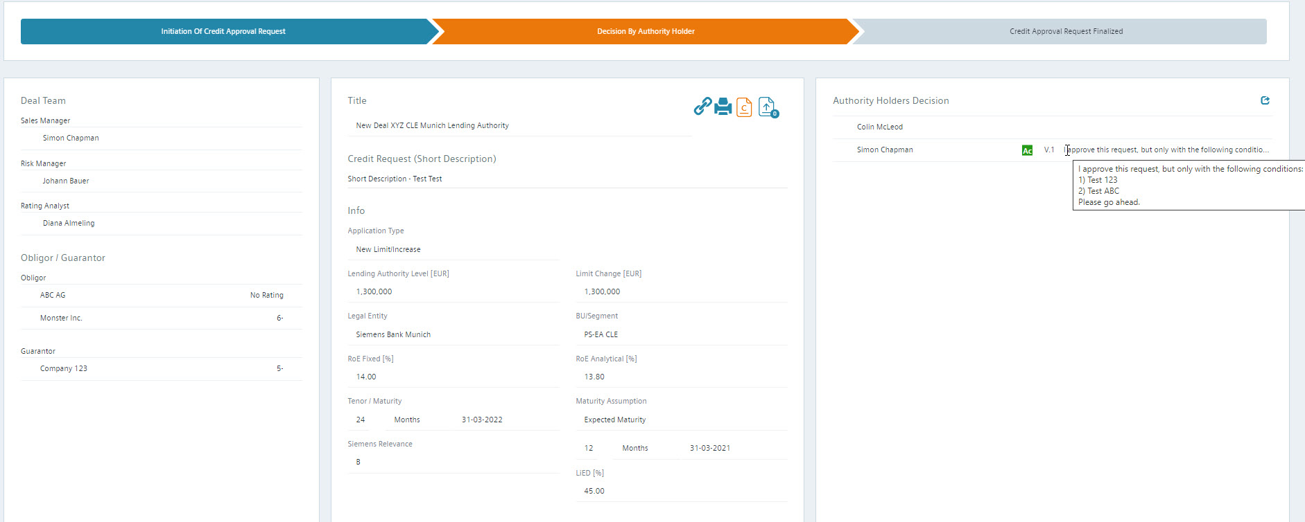
“Decision by Authority Holder“ II

Slide 16
Committee process
PS-EA

Slide 17
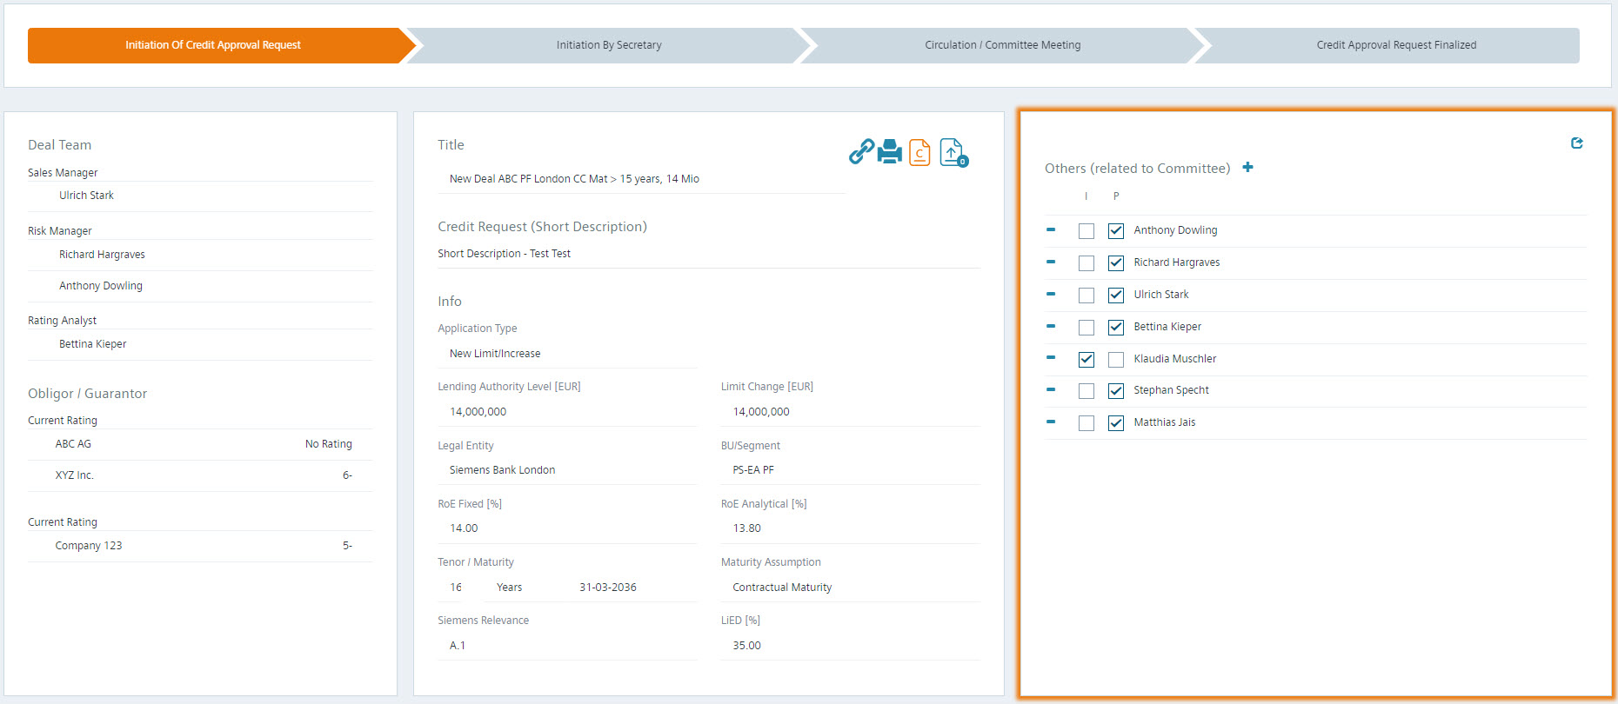
Risk Management phase “Initiation of Credit Approval Request“ I
Others (related to Committee)
Persons who should participate in the committee meeting or who should be informed about the meeting. Possibility for the risk manager to provide the list of involved persons to the committee secretary
Pre-fill logic:
1) Deal Team
2) Business Administrator can define persons per BU/Segment and Legal Entity

Slide 18
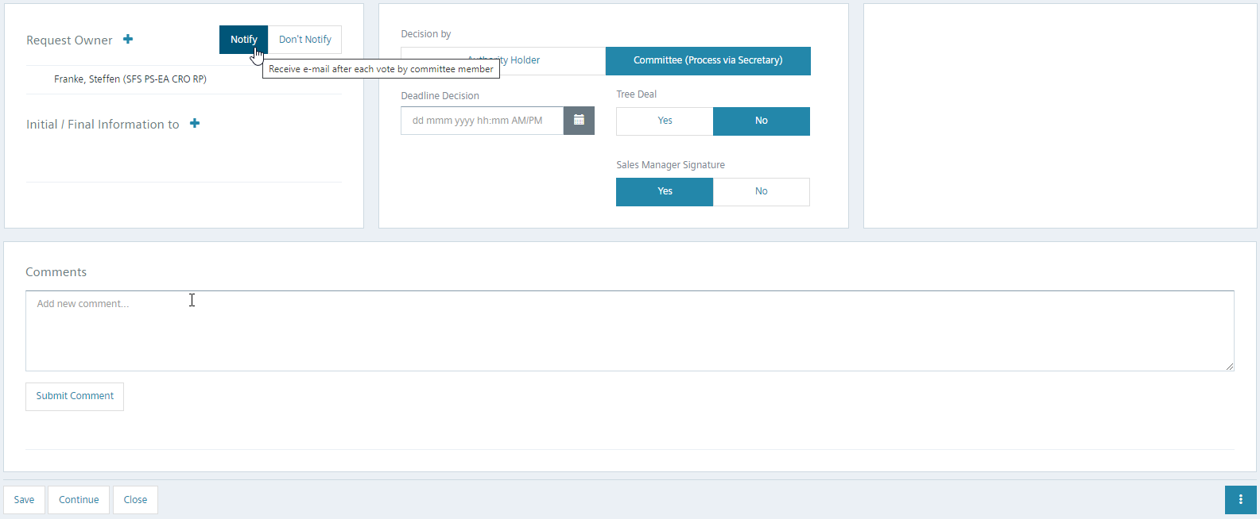
Risk Management phase “Initiation of Credit Approval Request“ II
„Notify“ vs. „Don‘t Notify“
Select, whether all persons listed as „Request Owner“ should receive an information e-mail with every vote by a Committee Member

Slide 19
Committee process
PS-AM

Slide 20
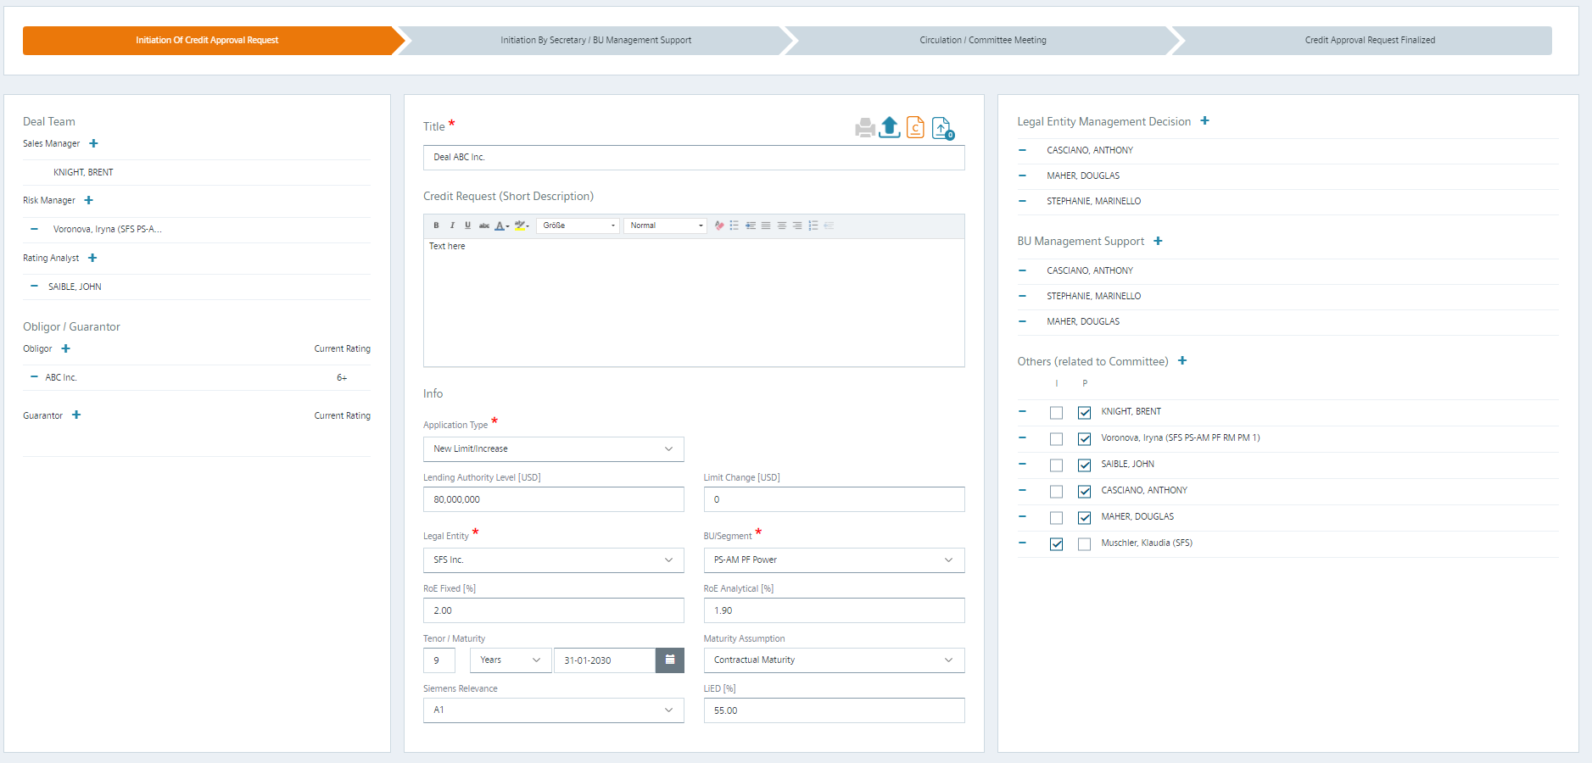
Risk Management phase “Initiation of Credit Approval Request“ I
Legal Entity Management Decision
  Board of the Legal Entity (SFS Inc., SF Ltd., SPI), who need to approve the deal
BU Management Support
  Board of the BU (PS-AM) Legal Entity Management, who need to provide support prior to Credit Committee
Button 1) (printer) open request overview incl. signatures
Button 2) (arrow) Upload approval document (e.g. Credit Report PDF) (if manual initiated and not from WILL)
Button 3) (orange document icon with „c“) Open approval document (e.g. Credit Report PDF)
Button 4) (blue document icon with arrow) Open / attach further documents (e.g. Credit Committee Presentation)
Others (related to Committee)
Persons who should participate in the committee meeting or who should be informed about the meeting. Possibility for the risk manager to provide the list of involved persons to the committee secretary
Pre-fill logic:
1) Deal Team
2) Business Administrator can define persons per BU/Segment and Legal Entity

Slide 21

Risk Management phase “Initiation of Credit Approval Request“ II
„Notify“ vs. „Don‘t Notify“
Select, whether all persons listed as „Request Owner“ should receive an information e-mail with every vote by a Committee Member

Slide 22
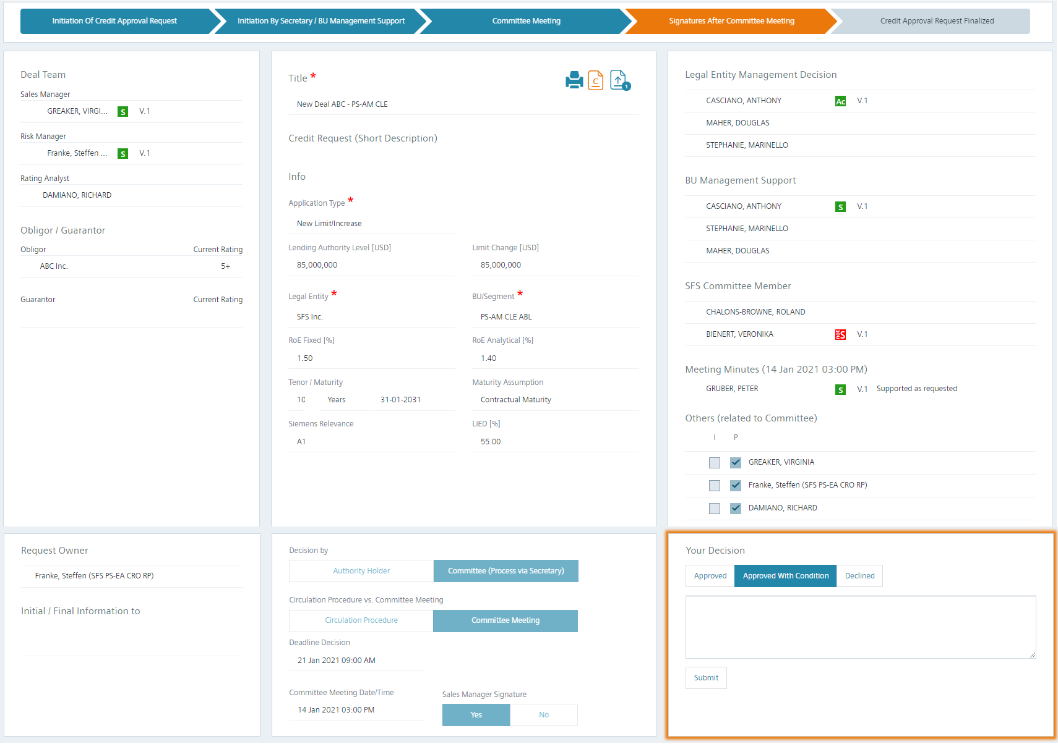
Decision / Support by Legal Entity Management / BU Management
Open approval document (e.g. Credit Report PDF) (orange document icon with „c“)
Open additional documents (e.g. Credit Committee presentation)
All decisions / advises of authorities and Credit Committee meeting minutes
Approved / Supported
Approved / Supported with Conditions
Declined / Not Supported
Orange frame around tiles which require action
Select decision / advice
  Approved, Approved with Condition or Declined
  Supported, Supported with Conditions, Not Supported
Click on “Submit“ to save your decision / advise

Slide 23
Contact
Published by Siemens Bank GmbH – Risk Processes & Tools
  Steffen Franke
SFS PS-EA CRO RP
Mobile +49 173 31 97 41 3
  E-mail steffen.franke@siemens.com
  Raika Schneider
SFS PS-EA CRO RP
Mobile +49 172 32 72 32 5
  E-mail raika.schneider@siemens.com
Contacts for US workflow – Risk Processes & Tools
  Joseph Alvarez
SFS PS-AM CRO RP
Mobile +1 (732) 98 38 406
  E-mail joseph.alvarez@siemens.com
  Cinthya Medina
SFS PS-AM CRO RP
  E-mail cinthya.medina@siemens.com

