Slide 1









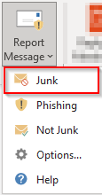






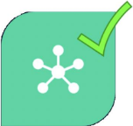

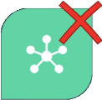






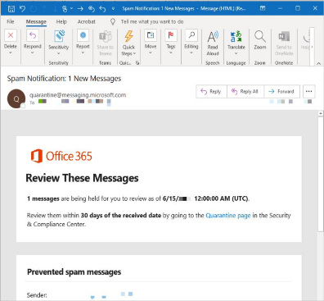



Restricted © Siemens 2021, IT IN COL Version 2.0
September 7, 2021
^{Email Security} processes in other tenants may vary.
Applies to the Siemens AG Tenant, settings and
_{Phishing}
SPAM Junk
Phishing is the attempt to obtain sensitive information or
data, such as usernames, passwords, and credit card
details by impersonating oneself as someone trustworthy.
Use this button in Outlook to report Phishing:
Spam emails are unsolicited and unwanted emails sent out in
bulk to an indiscriminate recipient list.
Junk emails are unsolicited advertisements that arrive in
your mailbox. They are not fraudulent or illegal.
Use this button in Outlook to report SPAM:
Use this button in Outlook to report Junk:
Find more information about
https://intranet.siemens.com/phishing
Find more information about :
https://intranet.siemens.com/spam
Find more information about :
https://intranet.siemens.com/junk
rt spam using this button in Outlook:
Register for Connected Experiences
Safe Links & Safe Attachments
Safe Links & Safe Attachments is a service that searches incoming emails (attachments and links) in real time and filters them for SPAM and phishing indicators.
Safe Links secures a hyperlink to a website. You can verify it while you hover your mouse over the link - the small pop-up text will show the “Original URL”.
This means the link has been protected by Safe Links:
Safe Attachments provides an additional layer of protection for email attachments that have already been scanned by malware detection engine.
Malicious attachments will be quarantined, and you will get a notification from quarantine@messaging.microsoft.com by email to check your attachments.
Find more information about Safe Links & Safe Attachments: https://intranet.siemens.com/safelink

